Slide 1
CS242 Midterm Review
By Shihab Rashid
Thanks to Merlin Mao, Nhat Le, Matthew Wiley, and Shiwen Cheng for Slides!

Slide 2
Agenda
High level discussion (Ch. 1 & 2)
An overview of IR and Search Engines
Indexing
User Interaction
Exercises covering the following topics
Inverted Indexes (Ch. 3)
Retrieval Models:
Boolean retrieval (Ch. 7)
Vector Space Models (Ch. 7)
Language Models (Ch. 7)
Evaluation (Ch. 8)
BM25 Review (Ch. 7)
PageRank (link-based search)
Query Execution (Ch. 5)
MapReduce (Ch. 5)

Slide 3
An Overview of IR – Discussion
What are the differences between IR and DB search?
What are the challenges of IR search?
What is Relevance?
Topical vs User Relevance?
How are IR applications evaluated? What measures are used?

Slide 4
Indexing

Slide 5
Indexing – Discussion
Text Acquisition
Coverage & Freshness
Crawlers, Web vs File System vs Feeds
Document Conversion and Storage
Text Transformation
Parsing, Tokenization, Stopping, Stemming & Markup
Information Extraction
Classification
Index Creation
Document Statistics
Weighting
Inversion

Slide 6
User Interaction

Slide 7
User Interaction – Discussion
Query Input
Interface
Semantics
Transformation
Techniques
Output
Methods
Ranking
Performance
Evaluation
Logging, Ranking, Performance Analysis

Slide 8
Agenda
High level discussion
An overview of IR and Search Engines
Indexing
User Interaction
Exercises covering the following topics
Inverted Indexes
Retrieval Models:
Boolean retrieval
Vector Space Models
Language Models
Evaluation
BM25 Review
PageRank
Query Execution
MapReduce

Slide 9
Inverted Index
Each posting has document id and other information(tf, time, position etc.),
Exercise: construct the inverted index for the example documents. Presented in the form of doc_id (tf):
Documents:
d1: “New York times”
d2: “New York post”
d3: “Los Angeles times”

Slide 10
Inverted Index
new: d1 (1) , d2 (1)
york: d1 (1), d2 (1)
times: d1 (1), d3 (1)
post: d2 (1)
los: d3 (1)
angeles: d3 (1)
Documents:
d1: “New York times”
d2: “New York post”
d3: “Los Angeles times”

Slide 11
Agenda
High level discussion
An overview of IR and Search Engines
Indexing
User Interaction
Exercises covering the following topics
Inverted Indexes
Retrieval Models:
Boolean retrieval
Vector Space Models
Language Models
Evaluation
BM25 Review
PageRank
Query Execution
MapReduce

Slide 12
Boolean Retrieval – Exercise
AND, OR, NOT
“new” AND ”york”
“new” OR “times”
“new” AND “york” NOT “post”
Advantages and disadvantages?
Documents:
d1: “New York times”
d2: “New York post”
d3: “Los Angeles times”

Slide 13
Vector Space Model
Query and Document are presented as term vectors with tf-idf weighting.
Discussion: Advantages and Disadvantages?
Use VSM for ranking, the first step is to build query and document vectors!

Slide 14
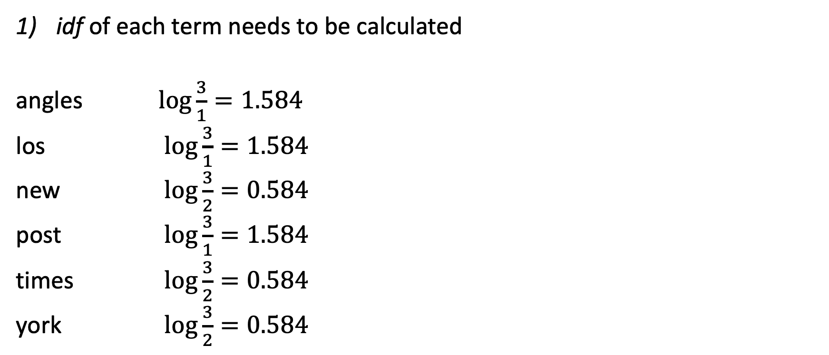
idf
idf of each term needs to be calculated
angles $\log{\frac{3}{1}}=1.584$
los $\log{\frac{3}{1}}=1.584$
new $\log{\frac{3}{2}}=0.584$
post $\log{\frac{3}{1}}=1.584$
times $\log{\frac{3}{2}}=0.584$
york $\log{\frac{3}{2}}=0.584$
Documents:
d1: “New York times”
d2: “New York post”
d3: “Los Angeles times”

Slide 15
tf-idf Weighting
Documents:
d1: “New York times”
d2: “New York post”
d3: “Los Angeles times”
tf for each term in each document
tf-idf
 | angeles | los | new | post | times | york
d1 | 0 | 0 | 1 | 0 | 1 | 1
d2 | 0 | 0 | 1 | 1 | 0 | 1
d3 | 1 | 1 | 0 | 0 | 1 | 0
 | angeles | los | new | post | times | york
d1 | 0 | 0 | 0.584 | 0 | 0.584 | 0.584
d2 | 0 | 0 | 0.584 | 1.584 | 0 | 0.584
d3 | 1.584 | 1.584 | 0 | 0 | 0.584 | 0

Slide 16
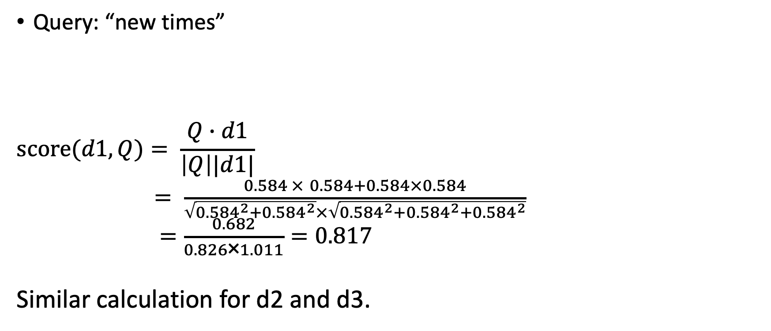
Vector Space Model – Exercise
Query: “new times”
$$score(d1,Q)= \frac{Q∙d1}{\left|Q\right||d1|}$$
$= \frac{0.584 × 0.584+0.584×0.584}{\sqrt{{0.584}^{2}+{0.584}^{2}}×\sqrt{{{0.584}^{2}+0.584}^{2}+{0.584}^{2}}}$
$=\frac{0.682}{0.826\text{×}1.011}=0.817$
Similar calculation for d2 and d3.
 | angeles | los | new | post | times | york
Q | 0 | 0 | 0.584 | 0 | 0.584 | 0
d1 | 0 | 0 | 0.584 | 0 | 0.584 | 0.584
d2 | 0 | 0 | 0.584 | 1.584 | 0 | 0.584
d3 | 1.584 | 1.584 | 0 | 0 | 0.584 | 0

Slide 17
Language Models
Uni-gram vs N-gram
Zipf’s Law
Frequencies of certain words are inversely proportional to their ranks
Discussion:
How do text transformations affect the model?
Smoothing:
Why?
How?

Slide 18
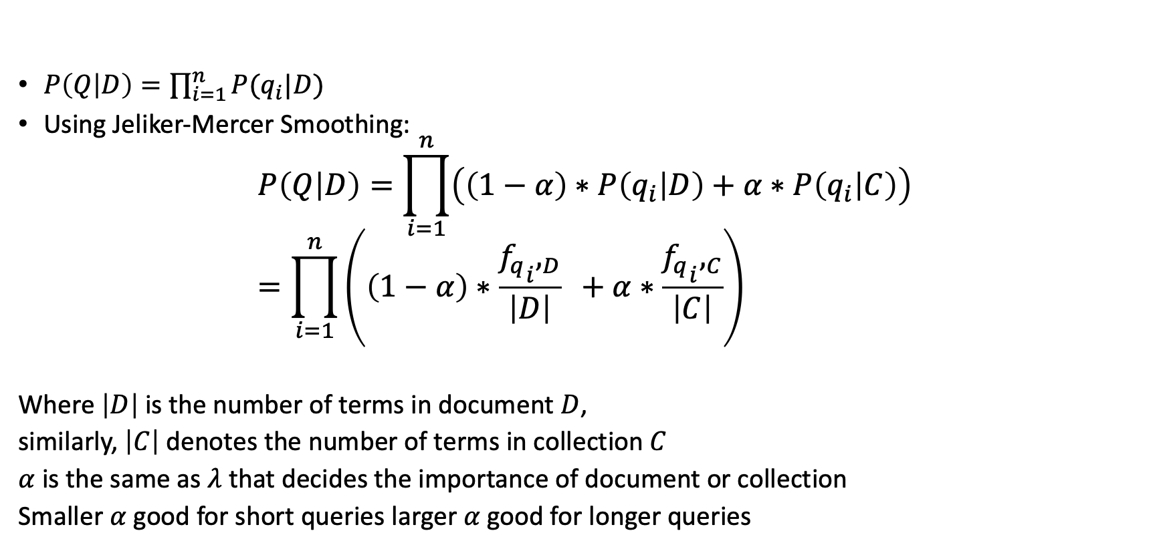
Language Model – Q given D
$P\left(Q | D\right)=\prod_{i=1}^{n}{P(q_{i}|D)}$
Using Jeliker-Mercer Smoothing:
$$P\left(Q | D\right)=\prod_{i=1}^{n}{\left(\left(1−α\right)∗P\left(q_{i} | D\right)+α∗P\left(q_{i} | C\right)\right)} \\ =\prod_{i=1}^{n}{\left(\left(1−α\right)∗\frac{{{f_{q}}_{i},}_{D}}{\left|D\right|} +α∗\frac{{{f_{q}}_{i},}_{C}}{\left|C\right|}\right)}$$
Where $\left|D\right|$ is the number of terms in document $D$,
similarly, $\left|C\right|$ denotes the number of terms in collection $C$
$α$ is the same as $λ$ that decides the importance of document or collection
Smaller $α$ good for short queries larger $α$ good for longer queries

Slide 19

Language Model – Exercise
Q: “new times”
Set $α$ = 0.5
$LM\left(Q, d1\right)=\left(0.5×\frac{1}{3}+0.5×\frac{2}{9}\right)∗\left(0.5×\frac{1}{3}+0.5×\frac{2}{9}\right)$

Slide 20
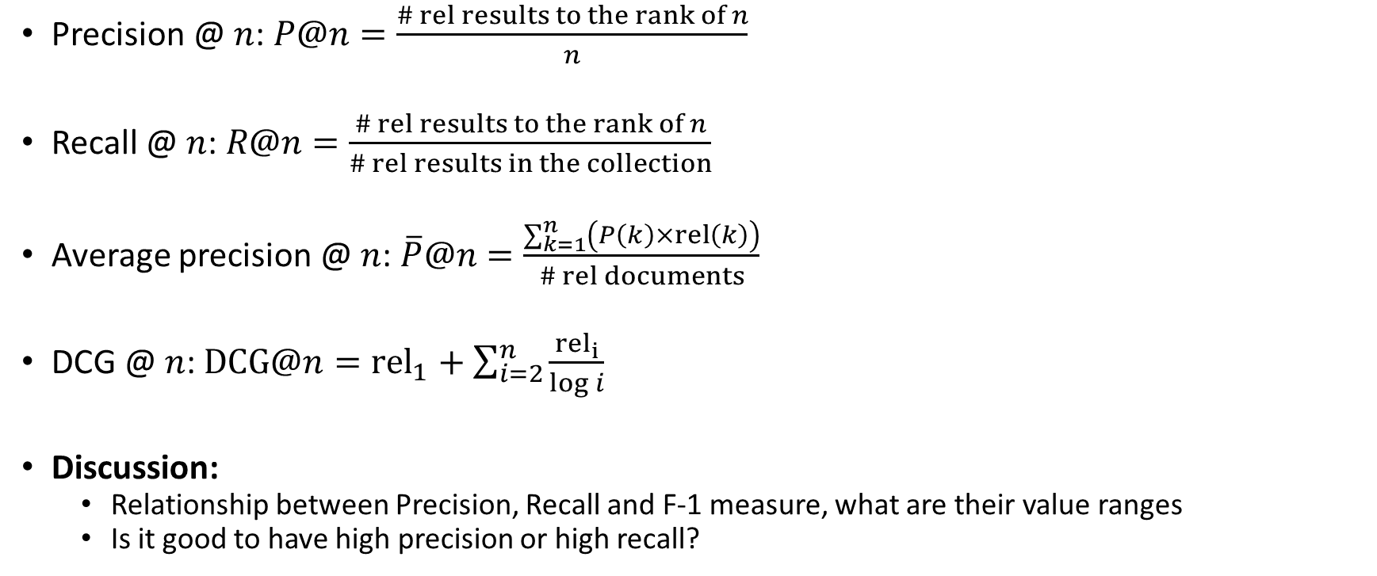
Ranking Evaluation
Precision @ $n$: $P@n=\frac{\# rel results to the rank of n}{n}$
Recall @ $n$: $R@n=\frac{\# rel results to the rank of n}{\# rel results in the collection}$
Average precision @ $n$: $\overline{P}@n=\frac{\sum_{k=1}^{n}{\left(P\left(k\right)×rel\left(k\right)\right)}}{\# rel documents}$
DCG @ $n$: $DCG@n={rel}_{1}+\sum_{i=2}^{n}{\frac{{rel}_{i}}{\log{i}}}$
Discussion:
Relationship between Precision, Recall and F-1 measure, what are their value ranges
Is it good to have high precision or high recall?

Slide 21
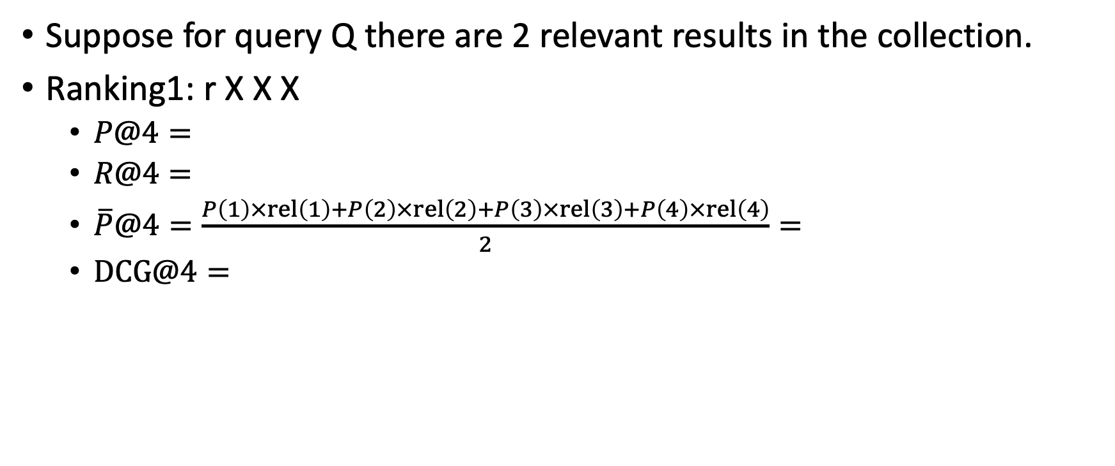
Evaluation – Exercise
Suppose for query Q there are 2 relevant results in the collection.
Ranking1: r X X X
$P@4=$
$R@4=$
$\overline{P}@4=\frac{P\left(1\right)×rel\left(1\right)+P\left(2\right)×rel\left(2\right)+P\left(3\right)×rel\left(3\right)+P\left(4\right)×rel\left(4\right)}{2}=$
$DCG@4=$

Slide 22
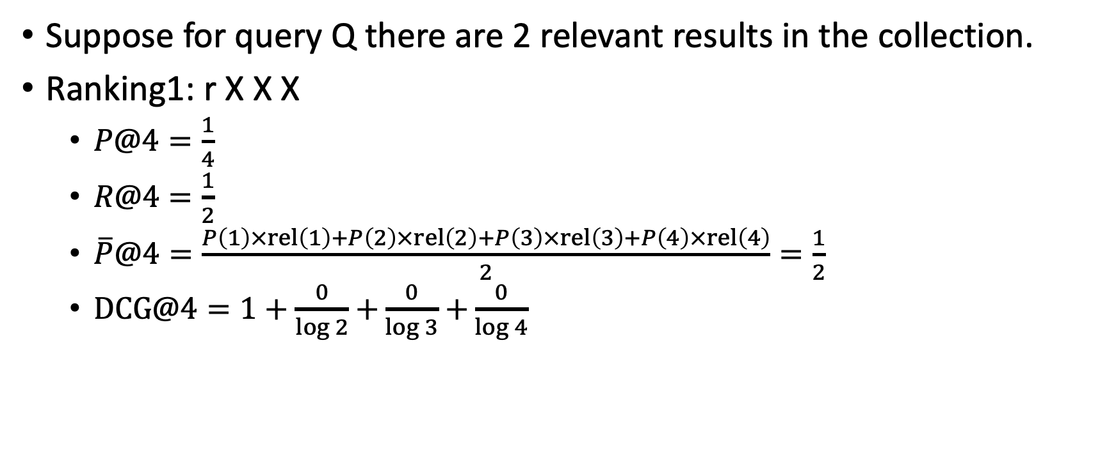
Evaluation – Exercise
Suppose for query Q there are 2 relevant results in the collection.
Ranking1: r X X X
$P@4=\frac{1}{4}$
$R@4=\frac{1}{2}$
$\overline{P}@4=\frac{P\left(1\right)×rel\left(1\right)+P\left(2\right)×rel\left(2\right)+P\left(3\right)×rel\left(3\right)+P\left(4\right)×rel\left(4\right)}{2}=\frac{1}{2}$
$DCG@4=1+\frac{0}{\log{2}}$ $+\frac{0}{\log{3}}$ $+\frac{0}{\log{4}}$

Slide 23

Evaluation – Exercise
Ranking2: X X r r
$P@4=$
$R@4=$
$\overline{P}@4=\frac{P\left(1\right)×rel\left(1\right)+P\left(2\right)×rel\left(2\right)+P\left(3\right)×rel\left(3\right)+P\left(4\right)×rel\left(4\right)}{2}=$
$DCG@4=$

Slide 24
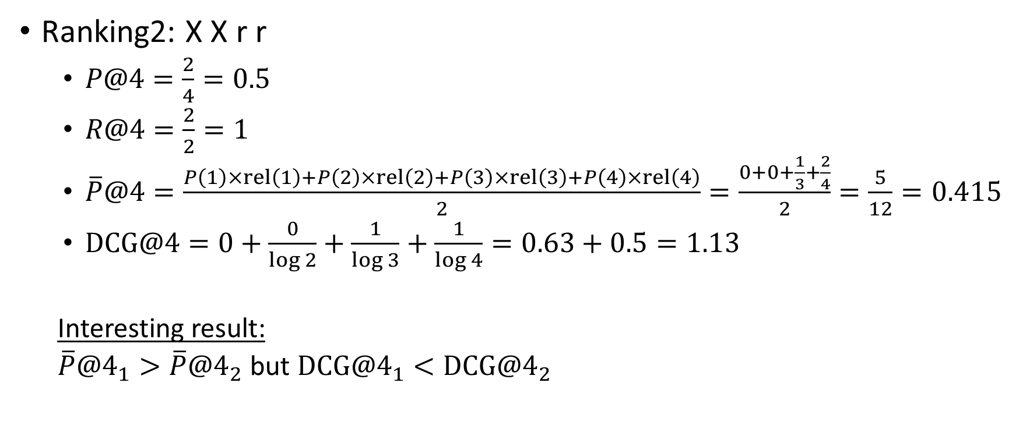
Evaluation – Exercise
Ranking2: X X r r
$P@4=\frac{2}{4}=0.5$
$R@4=\frac{2}{2}=1$
$\overline{P}@4=\frac{P\left(1\right)×rel\left(1\right)+P\left(2\right)×rel\left(2\right)+P\left(3\right)×rel\left(3\right)+P\left(4\right)×rel\left(4\right)}{2}=\frac{0+0+\frac{1}{3}+\frac{2}{4}}{2}=\frac{5}{12}=0.415$
$DCG@4=0+\frac{0}{\log{2}}+\frac{1}{\log{3}}+\frac{1}{\log{4}}=0.63+0.5=1.13$
Interesting result:
${\overline{P}@4}_{1}>{\overline{P}@4}_{2}$ but ${DCG@4}_{1}<{DCG@4}_{2}$

Slide 25

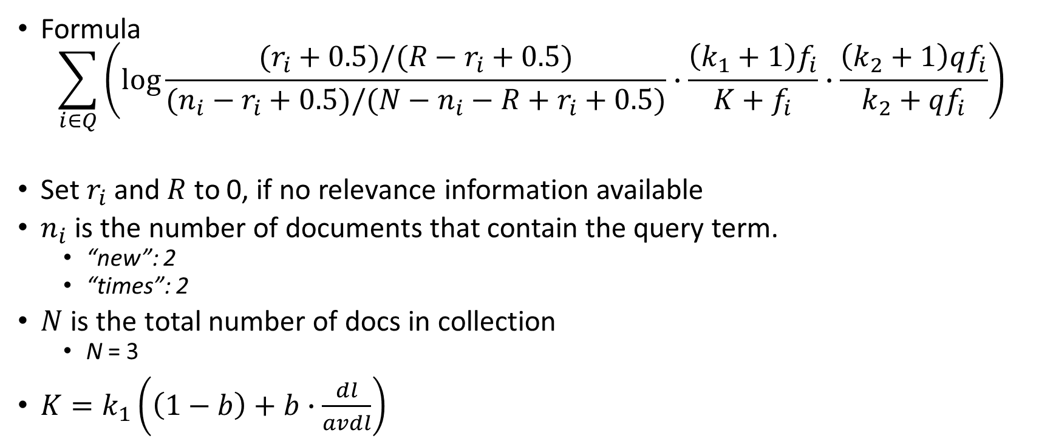
BM25 – Review
Formula
$$\sum_{i∈Q}{\left(\log{\frac{(r_{i}+0.5)/(R−r_{i}+0.5)}{(n_{i}−r_{i}+0.5)/(N−n_{i}−R+r_{i}+0.5)}∙\frac{\left(k_{1}+1\right)f_{i}}{K+f_{i}}∙\frac{\left(k_{2}+1\right)qf_{i}}{k_{2}+qf_{i}}}\right)}$$
Set $r_{i}$ and $R$ to 0, if no relevance information available
$n_{i}$ is the number of documents that contain the query term.
“new”: 2
“times”: 2
$N$ is the total number of docs in collection
N = 3
$K=k_{1}\left(\left(1−b\right)+b∙\frac{dl}{avdl}\right)$
$r_{i}$: # relevant documents contain term $i$
$R$: total # relevant documents
$n_{i}$: # documents contain term $i$
$N$: total # documents
$f_{i}$: term frequency in document
${qf}_{i}$: term frequency in query

Slide 26
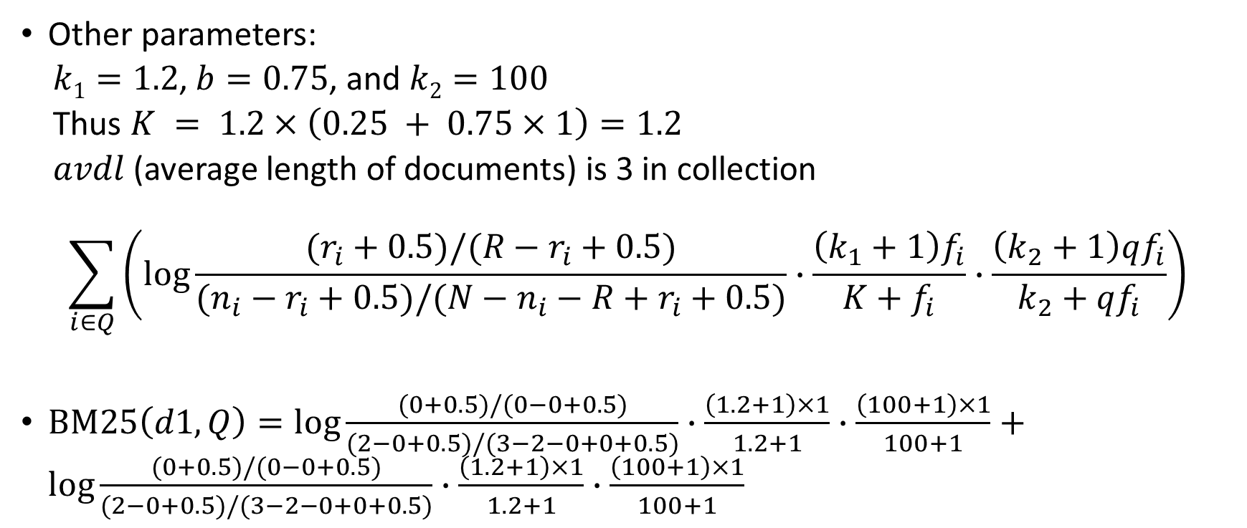
BM25
Other parameters:
$k1=1.2$, $b=0.75$, and $k2=100$
Thus $K = 1.2×\left(0.25 + 0.75×1\right)=1.2$
$avdl$ (average length of documents) is 3 in collection
$$\sum_{i∈Q}{\left(\log{\frac{(r_{i}+0.5)/(R−r_{i}+0.5)}{(n_{i}−r_{i}+0.5)/(N−n_{i}−R+r_{i}+0.5)}∙\frac{\left(k_{1}+1\right)f_{i}}{K+f_{i}}∙\frac{\left(k_{2}+1\right)qf_{i}}{k_{2}+qf_{i}}}\right)}$$
$BM25\left(d1, Q\right)=\log{\frac{(0+0.5)/(0−0+0.5)}{(2−0+0.5)/(3−2−0+0+0.5)}∙\frac{\left(1.2+1\right)×1}{1.2+1}∙\frac{\left(100+1\right)×1}{100+1}}+\log{\frac{(0+0.5)/(0−0+0.5)}{(2−0+0.5)/(3−2−0+0+0.5)}∙\frac{\left(1.2+1\right)×1}{1.2+1}∙\frac{\left(100+1\right)×1}{100+1}}$

Slide 27
PageRank Calculation
PR(A)=(1-d)/N + d*(PR(T1)/C(T1)+…+ PR(Tn)/C(Tn))
d: damping factor, normally this is set to 0.85.
T1, …, Tn: pages pointing to page A
PR(A): PageRank of page A.
PR(Ti): PageRank of page Ti.
C(Ti): the number of links going out of page Ti.
N: # pages
Note: d is needed due to PageRank sinks
r = (1-d)E + dMr, r: column-matrix of PRs
M: adjacency matrix of Web graph
E: Base-set column-matrix

Slide 28
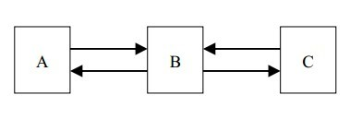

PageRank – Exercise
The number of web pages $N=3$
The damping parameter $d=0.8$

Slide 29
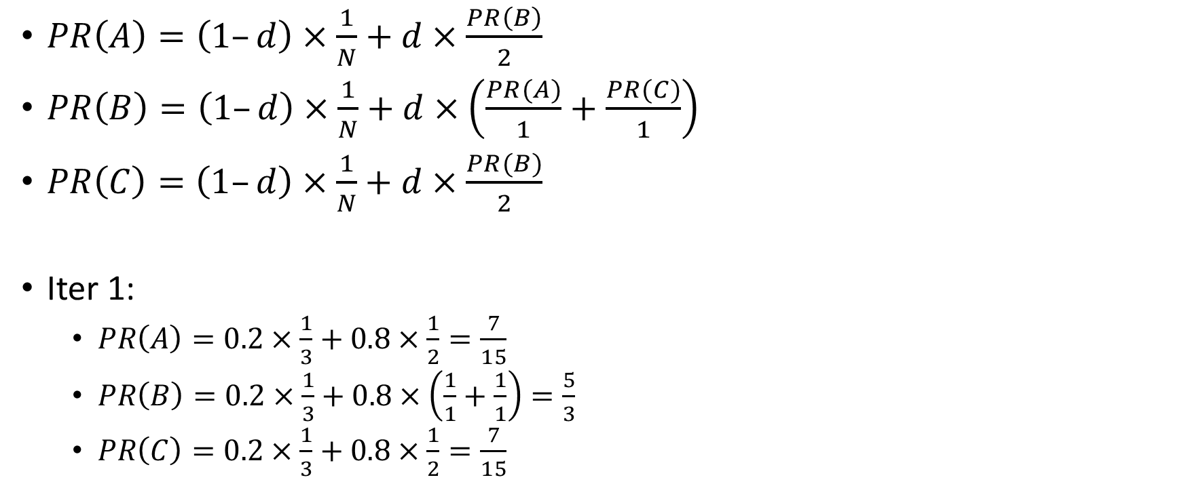
PageRank – Exercise
$PR\left(A\right)=\left(1–d\right)×\frac{1}{N}+d×\frac{PR\left(B\right)}{2}$
$PR\left(B\right)=\left(1–d\right)×\frac{1}{N}+d×\left(\frac{PR(A)}{1}+\frac{PR(C)}{1}\right)$
$PR\left(C\right)=\left(1–d\right)×\frac{1}{N}+d×\frac{PR(B)}{2}$
Iter 1:
$PR\left(A\right)=0.2×\frac{1}{3}+0.8×\frac{1}{2}=\frac{7}{15}$
$PR\left(B\right)=0.2×\frac{1}{3}+0.8×\left(\frac{1}{1}+\frac{1}{1}\right)=\frac{5}{3}$
$PR\left(C\right)=0.2×\frac{1}{3}+0.8×\frac{1}{2}=\frac{7}{15}$

Slide 30

PageRank – Exercise
Iter 1:
$PR\left(A\right)=0.2×\frac{1}{3}+0.8×\frac{1}{2}=\frac{7}{15}$
$PR\left(B\right)=0.2×\frac{1}{3}+0.8×\left(\frac{1}{1}+\frac{1}{1}\right)=\frac{5}{3}$
$PR\left(C\right)=0.2×\frac{1}{3}+0.8×\frac{1}{2}=\frac{7}{15}$
Iter 2:
$PR\left(A\right)=0.2×\frac{1}{3}+0.8×\frac{5/3}{2}=0.733$
$PR\left(B\right)=0.2×\frac{1}{3}+0.8×\left(\frac{7/15}{1}+\frac{7/15}{1}\right)=0.465$
$PR\left(C\right)=0.2×\frac{1}{3}+0.8×\frac{5/3}{2}=0.733$
Iter 3, 4 ....until convergence
Discussion:
How to modify PageRank to give specific pages higher importance?

Slide 31
Agenda
High level discussion
An overview of IR and Search Engines
Indexing
User Interaction
Exercises covering the following topics
Inverted Indexes
Retrieval Models:
Boolean retrieval
Vector Space Models
Language Models
Evaluation
BM25 Review
PageRank
Query Execution
MapReduce

Slide 32
Query Processing – Discussion
Document-at-a-time
Term-at-a-time
Optimizations
Skipping
Pros and Cons?
Threshold Methods (i.e. Fagin’s Algorithm)
What is the threshold?

Slide 33
Document-At-A-Time

Slide 34
Term-At-A-Time

Slide 35
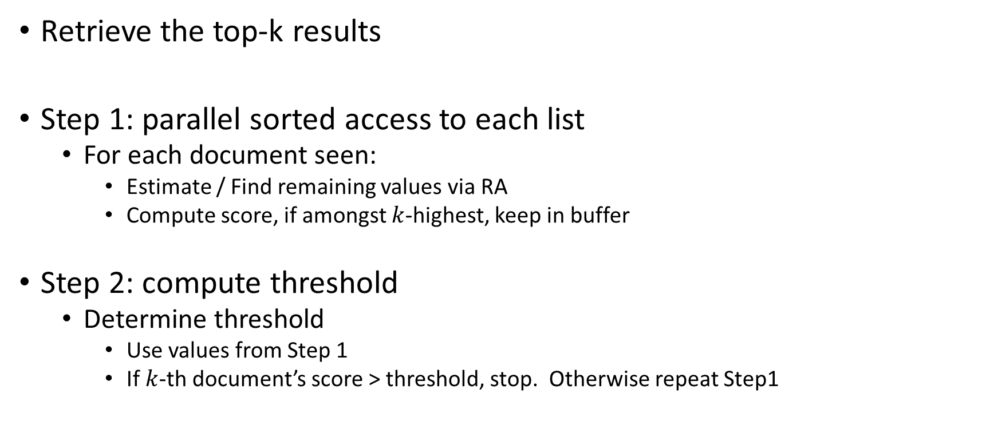
Threshold Algorithm
Retrieve the top-k results
Step 1: parallel sorted access to each list
For each document seen:
Estimate / Find remaining values via RA
Compute score, if amongst $k$-highest, keep in buffer
Step 2: compute threshold
Determine threshold
Use values from Step 1
If $k$-th document’s score > threshold, stop. Otherwise repeat Step1

Slide 36
TA with RA – Iteration 1
L₁
L₂
(a, 0.95)
(e, 0.9)
Doc
T₁
T₂
Score
(b, 0.8)
(a, 0.85)
0.95
0.85
1.8
a
(c, 0.75)
(b, 0.7)
0.2
0.9
1.1
e
(e, 0.2)
(d, 0.5)
.
.
.
.
.
.
(d, 0.1)
(c, 0.2)
Threshold = 0.95 + 0.9 = 1.85

Slide 37
TA with RA – Iteration 2
L₁
L₂
(a, 0.95)
(e, 0.9)
Doc
T₁
T₂
Score
(b, 0.8)
(a, 0.85)
0.95
0.85
1.8
a
(c, 0.75)
(b, 0.7)
0.8
0.7
1.5
b
(e, 0.2)
(d, 0.5)
.
.
.
.
.
.
(d, 0.1)
(c, 0.2)
Threshold = 0.8 + 0.85 = 1.65

Slide 38
TA with RA – Iteration 3
L₁
L₂
(a, 0.95)
(e, 0.9)
Doc
T₁
T₂
Score
(b, 0.8)
(a, 0.85)
0.95
0.85
1.8
a
(c, 0.75)
(b, 0.7)
0.8
0.7
1.5
b
(e, 0.2)
(d, 0.5)
.
.
.
.
.
.
(d, 0.1)
(c, 0.2)
Threshold = 0.75 + 0.7 = 1.45
1.45 < 1.5, therefore terminate

Slide 39
TA with NRA – Iteration 1
L₁
L₂
(a, 0.95)
(e, 0.9)
Doc
T₁
T₂
Score
Estimate
(b, 0.8)
(a, 0.85)
0.95
1.85
a
(c, 0.75)
(b, 0.7)
0.9
1.85
e
(e, 0.2)
(d, 0.5)
.
.
.
.
.
.
(d, 0.1)
(c, 0.2)
Threshold = 0.95 + 0.9 = 1.85

Slide 40
TA with NRA – Iteration 2
L₁
L₂
(a, 0.95)
(e, 0.9)
Doc
T₁
T₂
Score
Estimate
(b, 0.8)
(a, 0.85)
0.95
0.85
1.8
1.8
a
(c, 0.75)
(b, 0.7)
0.9
1.7
e
(e, 0.2)
(d, 0.5)
0.8
1.65
b
.
.
.
.
.
.
(d, 0.1)
(c, 0.2)
Threshold = 0.8 + 0.85 = 1.65

Slide 41
TA with NRA – Iteration 3
L₁
L₂
(a, 0.95)
(e, 0.9)
Doc
T₁
T₂
Score
Estimate
(b, 0.8)
(a, 0.85)
0.95
0.85
1.8
1.8
a
(c, 0.75)
(b, 0.7)
0.9
1.65
e
(e, 0.2)
(d, 0.5)
0.8
0.7
1.5
1.5
b
.
.
.
.
.
.
0.75
1.45
c
(d, 0.1)
(c, 0.2)
Threshold = 0.75 + 0.7 = 1.45
1.45 < 1.5, therefore terminate

Slide 42

Fagin’s Algorithm – Discussion
Fagin’s Algorithm is similar to TA with NRA, but:
Read lists until $k$ objects have read a value for all terms
Use random access to compute the missing terms
Return the top-$k$ objects
Pros and Cons?

Slide 43
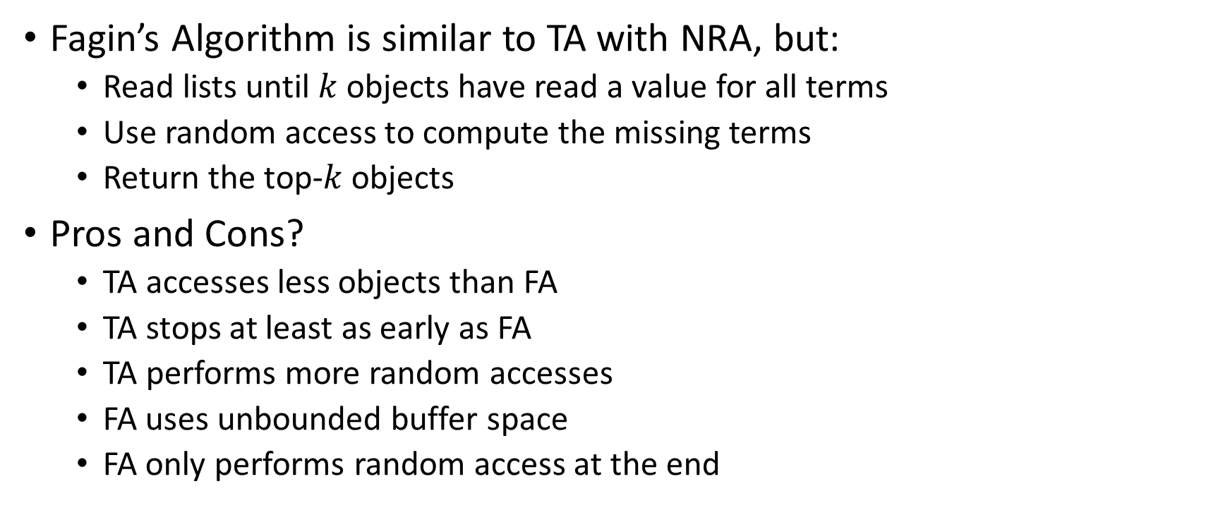
Fagin’s Algorithm
Fagin’s Algorithm is similar to TA with NRA, but:
Read lists until $k$ objects have read a value for all terms
Use random access to compute the missing terms
Return the top-$k$ objects
Pros and Cons?
TA accesses less objects than FA
TA stops at least as early as FA
TA performs more random accesses
FA uses unbounded buffer space
FA only performs random access at the end

Slide 44
Agenda
High level discussion
An overview of IR and Search Engines
Indexing
User Interaction
Exercises covering the following topics
Inverted Indexes
Retrieval Models:
Boolean retrieval
Vector Space Models
Language Models
Evaluation
BM25 Review
PageRank
Query Execution
MapReduce

Slide 45
MapReduce
Capabilities/limitations of MapReduce
Can MapReduce handle all types of jobs?
Output of MapReduce?
Example: Term frequency, unique terms, etc.
What is Mapper and Reducer
Relationship among the number of Mappers/Reducers, the number of clusters, and the number of inputs/outputs
Design question: in memory processing (e.g., HashMap) v.s. multiple rounds of MapReduce
Understand the WordCounter example

Slide 46
MapReduce – Exercise
Input:
Document with two fields: title and body
Output:
Four postings:
Title and body term frequencies
Title and body term positions

Slide 47
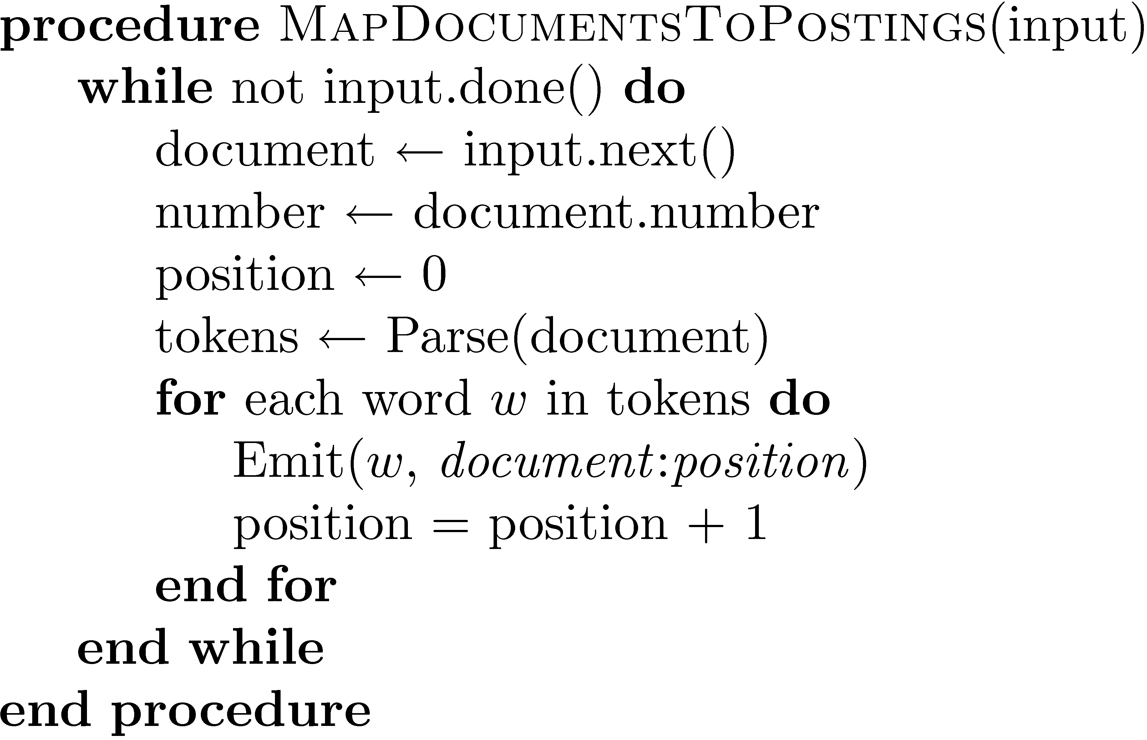
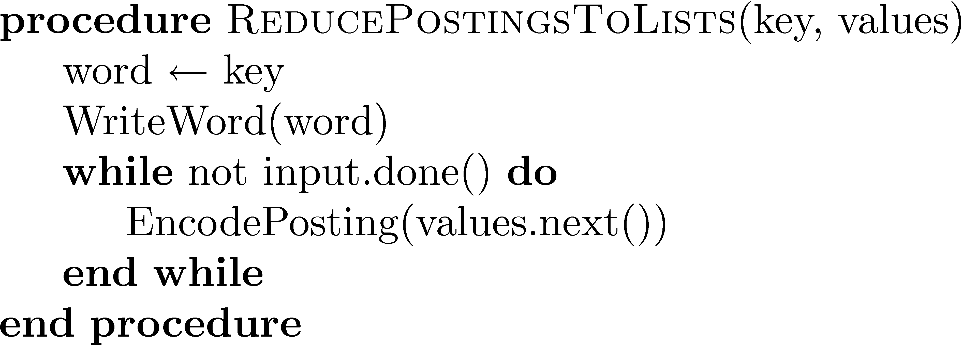
A partial solution

Slide 48
idf Using Combiners – Discussion
Most term count examples emit “1” for each term
Disadvantage?

Slide 49
idf Using Combiners – Discussion
Most term count examples emit “1” for each term
Inefficient: high amount of dummy counters
i.e. unnecessary disk reads during reducer phase
Mappers could use an associative array to sum all terms in each document processed

Slide 50
idf Using Combiners – Discussion
Most term count examples emit “1” for each term
Inefficient: high amount of dummy counters
i.e. unnecessary disk reads during reducer phase
Mappers could use an associative array to sum all terms in each document processed
Careful! Dynamic memory allocation may cause out of memory errors.
Alternative?

Slide 51
idf Using Combiners – Discussion
Most term count examples emit “1” for each term
Inefficient: high amount of dummy counters
i.e. unnecessary disk reads during reducer phase
Mappers could use an associative array to sum all terms in each document processed
Careful! Dynamic memory allocation may cause out of memory errors.
Most efficient:
Mappers emit “1” for each term, combiners then sum the dummy counters before reduce phase
No dynamic memory allocation
Reduces amount of disk reads

Slide 52
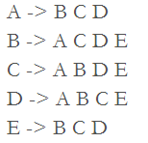
Friends in Common – Exercise
Input: List of friends for each user
Output: Friends in common for each pair of users (that are already friends)
Assume friendships are bidirectional
i.e. Facebook friendships

Slide 53
Friends in Common – Mapper
For each record A -> B C D
Emit friendship pair with list of friends
E.g., <(AB), (B C D)>
Idea:
Friendship relations are keys
All friends of the persons in the key are the value
Important! Keys must remain in order
B -> A C D E emits <(AB), (A C D E)>

Slide 54
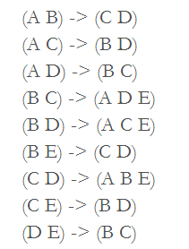
Friends in Common – Reducer
Intersect the list of values from each key-value pair
Each friendship shares the same key
Therefore the intersection will produce friends in common

Slide 55
References
Ilya Katsov’s blog on MapReduce Patterns, Algorithms, and Use Cases
http://highlyscalable.wordpress.com/2012/02/01/mapreduce-patterns/
Steve Krenzel’s blog on finding friends of friends
http://stevekrenzel.com/finding-friends-with-mapreduce

